Slide 1
Security Evaluation of Cloud Services
Malikov Ziya

Slide 2
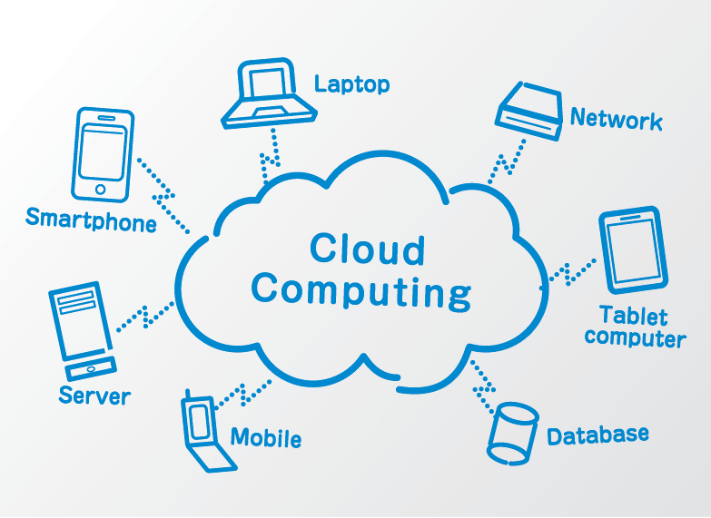
What is Cloud Computing?
The delivery of computing services (like storage, processing power, and software) over the internet. It allows users to access these services on-demand, without the need for internal infrastructure or hardware.
Why is it important?
Cost-Efficiency
Scalability
Accessibility
Business Continuity

Slide 3
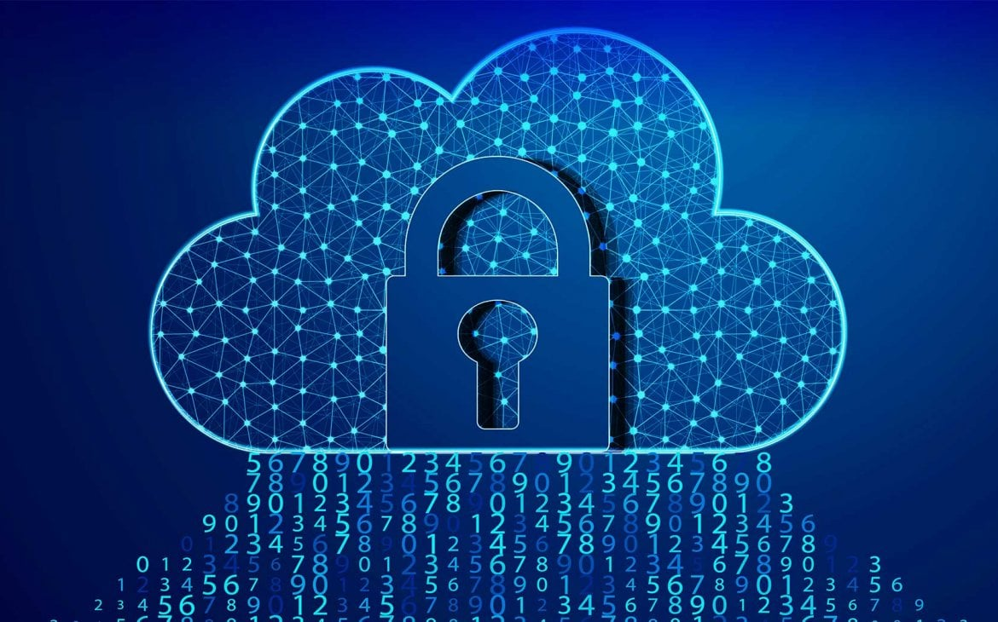
Cloud Security Overview
Why do we need Cloud Security?
Protect Sensitive Data from Unauthorized Access
Prevent Data Breaches
Ensure Compliance
Mitigate Cyber Threats
Maintain Business Continuity
Build Customer and Stakeholder Trust

Slide 4
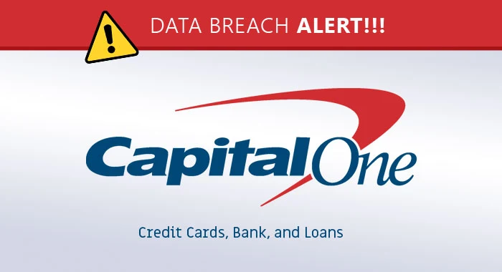
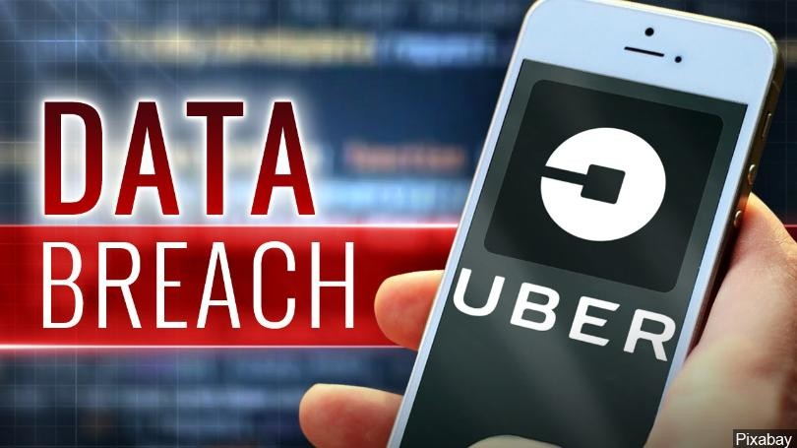
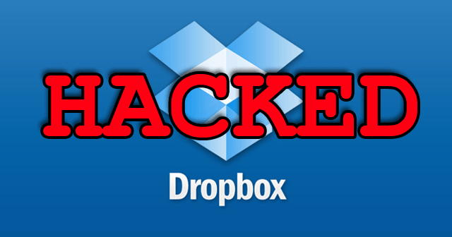
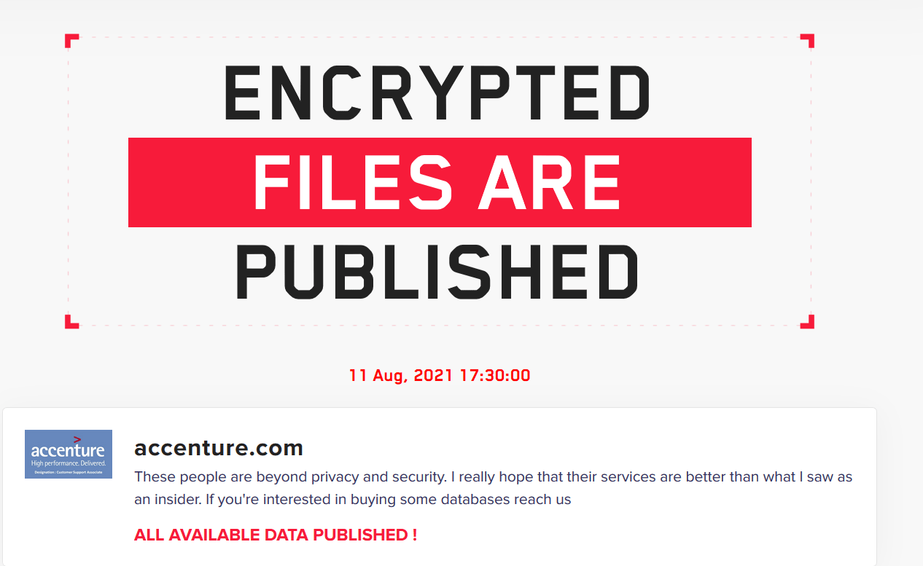
Most Famous Cloud Security Breaches
2019
2016
2012
2021

Slide 5
Preliminary Investigation Report

Slide 6
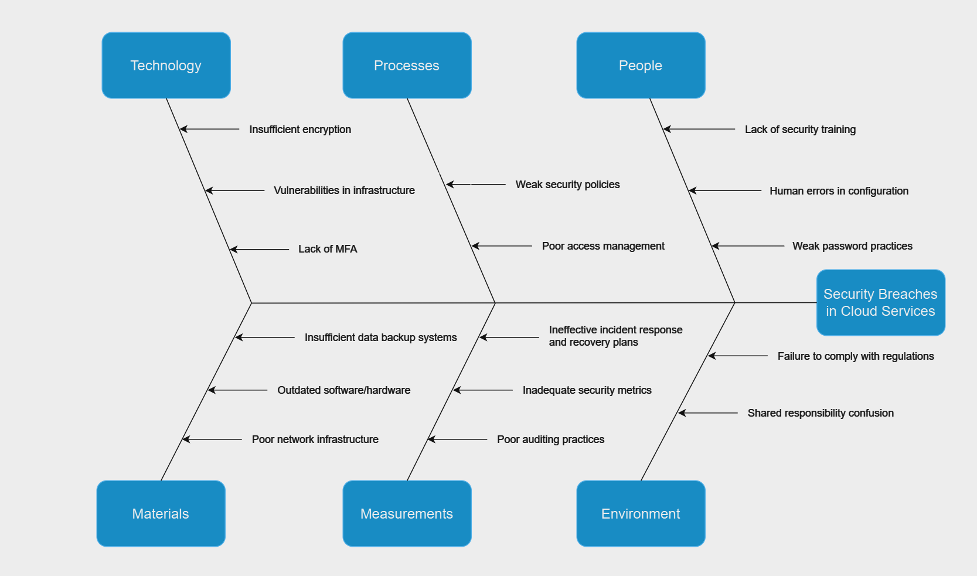
Fishbone Diagram

Slide 7
Project Scope
The main objective of this project is to conduct an in-depth evaluation of the security posture of cloud services through the development of a Cloud Security Evaluation App. The app will assess security vulnerabilities and compliance in cloud environments, while integrating with SIEM solutions for enhanced threat detection and response. This project will focus on ensuring that the app supports different cloud platforms, emphasizes security best practices, and incorporates the necessary tools for continuous monitoring and incident management.
Cloud Service Security Assessment
Integration with SIEM Solutions
Disaster Recovery and Business Continuity
Incident Detection and Response
Regulatory Compliance Evaluation
Data Protection

Slide 8
Deliverables
Cloud Security Evaluation App, complete with SIEM integration, automated security evaluation tools, compliance assessment capabilities, and real-time threat detection. The app will provide users with comprehensive reports and actionable recommendations to enhance cloud security.
Stakeholders
Organizations' IT Departments
Cloud Architects
Cloud Security Engineers
Security Analysts
Compliance Officers
End Users

Slide 9
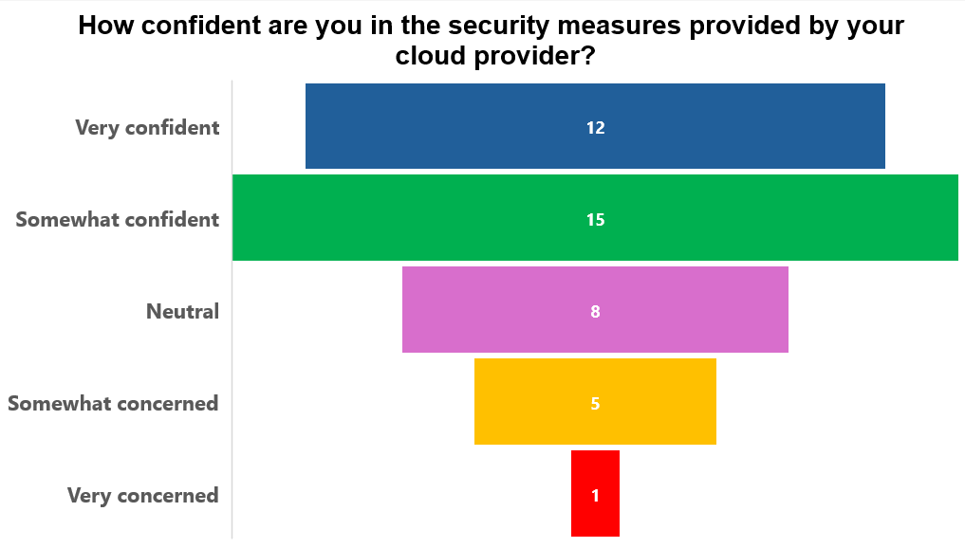
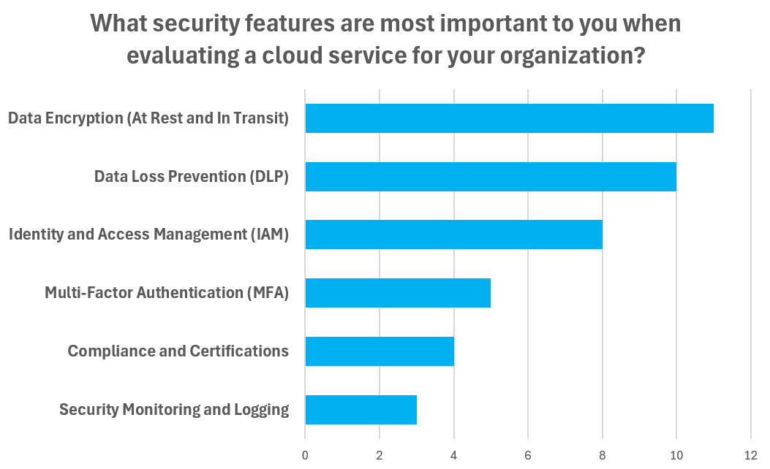
Fact Findings - Surveys

Slide 10
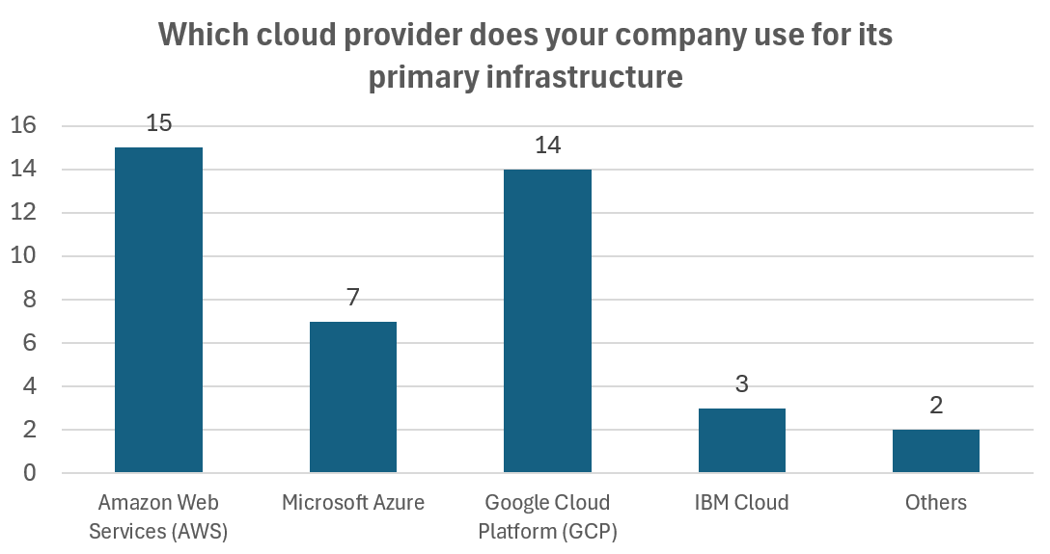
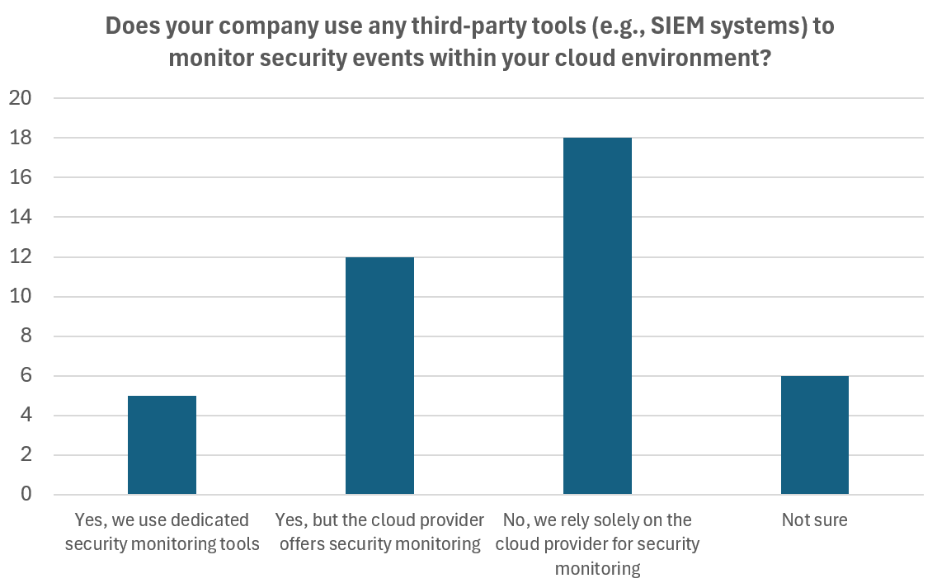
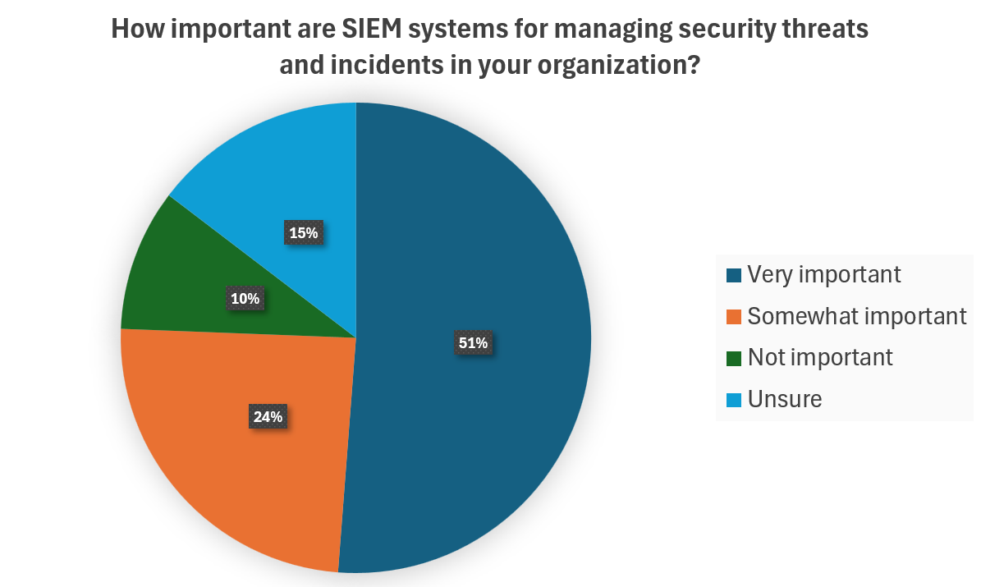

Slide 11
Evaluation of Feasibility
Operational Feasibility:
This project aims to provide a user-friendly tool to help IT teams and security professionals assess and improve cloud security. It will be compatible with major cloud platforms and integrate with SIEM solutions, addressing the growing need for cloud security and regulatory compliance. The tool’s simplicity and practicality make it suitable for businesses of all sizes, and there is strong demand for such a product in the current market.
SWOT:
Strengths: Meets the urgent need for cloud security evaluation and integrates with major cloud platforms and security tools, making it highly adaptable.
Weaknesses: User adoption, especially among smaller businesses without dedicated security teams, may be slow.
Opportunities: As cloud adoption grows, the demand for security tools like this will increase, offering significant market potential.
Threats: Competitors with broader features could impact adoption, but focusing on ease of use and targeted functionality will help differentiate the app.

Slide 12
Technical Feasibility:
The project is technically feasible as it involves creating an app that integrates with existing cloud platforms and security tools like SIEM systems. The key challenge will be ensuring the app can scan for security issues, check compliance, and provide accurate reports. Additionally, the app must be secure, using encryption to protect data during evaluations. Given the available technologies and cloud services, the project is achievable.
SWOT:
Strengths: The app will use widely supported cloud platforms and security tools, making integration feasible.
Weaknesses: Ensuring compatibility with different cloud services and maintaining security during data evaluation could be challenging.
Opportunities: The app can offer valuable automated security checks and integrate with SIEM systems to enhance cloud security.
Threats: Changes in cloud services or security standards could require updates, but these can be managed over time.

Slide 13
Economic Feasibility:
The primary expenses for this project will be related to cloud services, including AWS, Google Cloud, and Microsoft Azure. These platforms are estimated to cost at least $100 per month each, covering the essential services and tools needed for the project. As a student, we can benefit from free or discounted cloud services for up to two months, but if the project extends beyond this, additional funds will need to be allocated. Another major expense will be the cost of assembling a development team, with an estimated monthly cost of $200 per team member. Additionally, there may be costs for third-party tools and services required to enhance the functionality of the app, such as SIEM integrations or vulnerability scanning tools.
SWOT:
Strengths: Using student accounts for cloud services helps reduce costs, allowing us to maximize our budget.
Weaknesses: Limited budget for marketing and user acquisition could delay the project's visibility and adoption.
Opportunities: Potential revenue could be generated through partnerships or licensing the system to organizations in need of cloud security tools.
Threats: Some cloud services and third-party APIs may not be free, leading to unanticipated costs if the project runs longer than expected.

Slide 14
Schedule Feasibility: The project is set to be completed within a three-month timeframe, with a clear breakdown of tasks. The first two monthes will focus on research, design, and requirement gathering, while the third month will be dedicated to finalizing the design, testing, and preparing for deployment. To ensure the project stays on schedule, tasks will be prioritized and aligned with the available resources. Any delay may result in missed opportunities, so sticking to the timeline is critical.
Project Timeline:
Start date: 15.09.2024
Development and Planning: 8 weeks
Testing and Finalization: 4 weeks
Finish date: 14.12.2024
SWOT:
Strengths: Tasks can be completed in parallel, helping to expedite progress.
Weaknesses: Delays due to lack of resources or unforeseen issues can disrupt the schedule.
Opportunities: Agile methodology allows flexibility to adapt and reassign tasks if needed, ensuring continuous progress.
Threats: Unforeseen challenges or resource constraints could delay project completion, requiring additional time to address issues.

Slide 15
Requirement Analysis

Slide 16
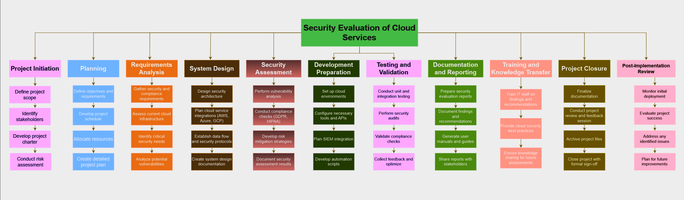
Work Breakdown Structure (WBS)
Report-based:

Slide 17
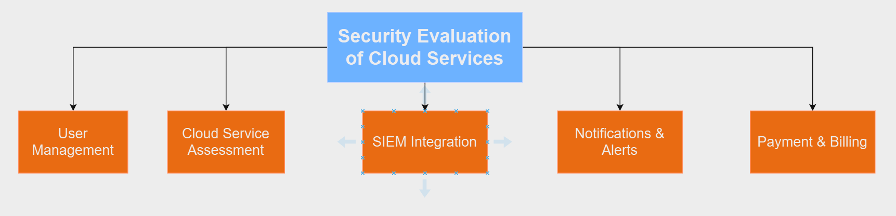
Work Breakdown Structure (WBS)
App-based:

Slide 18
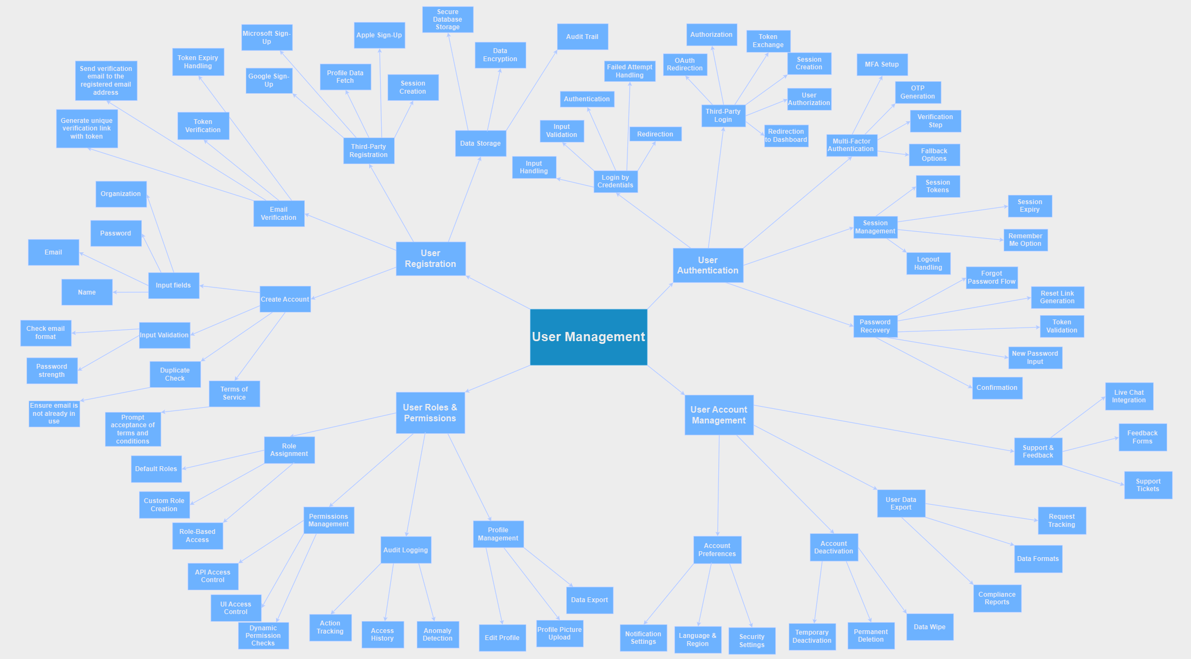

Slide 19
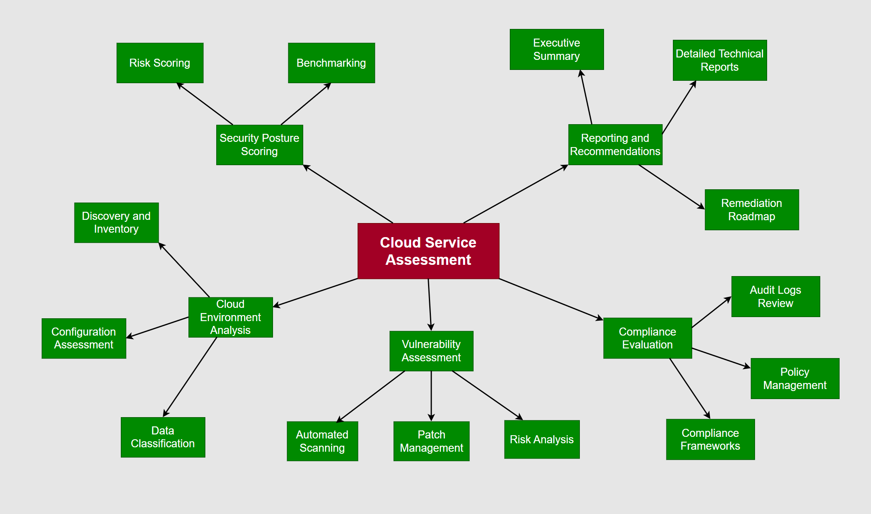

Slide 20
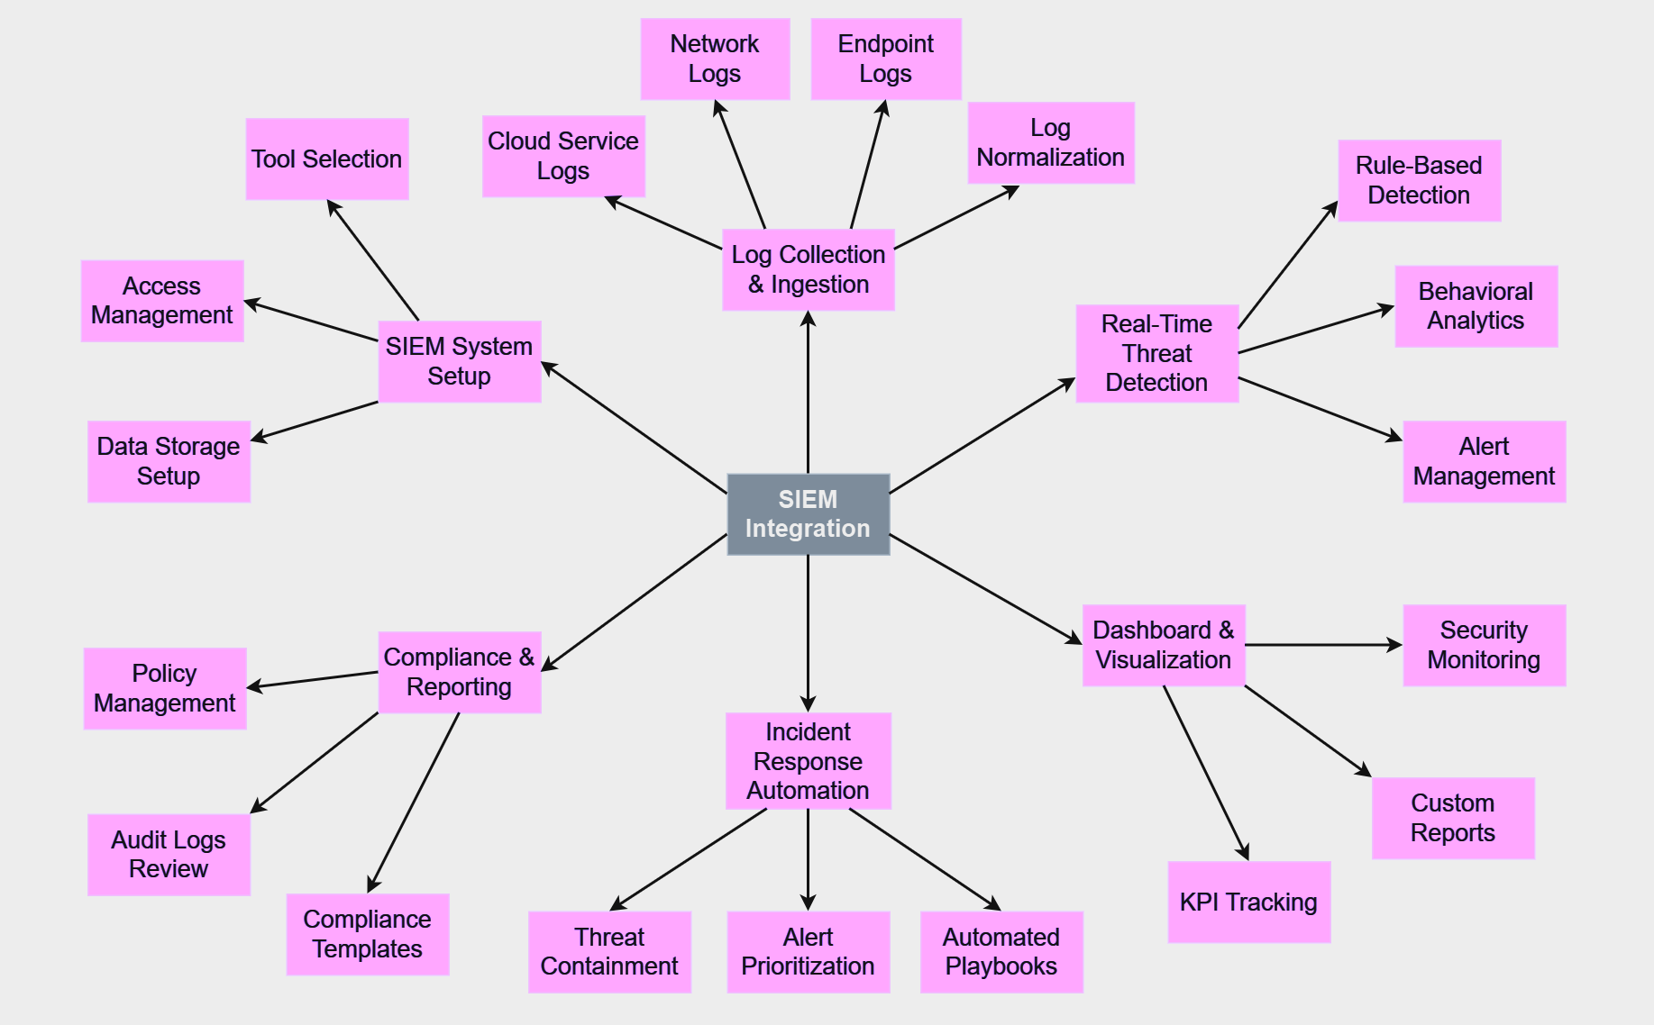

Slide 21
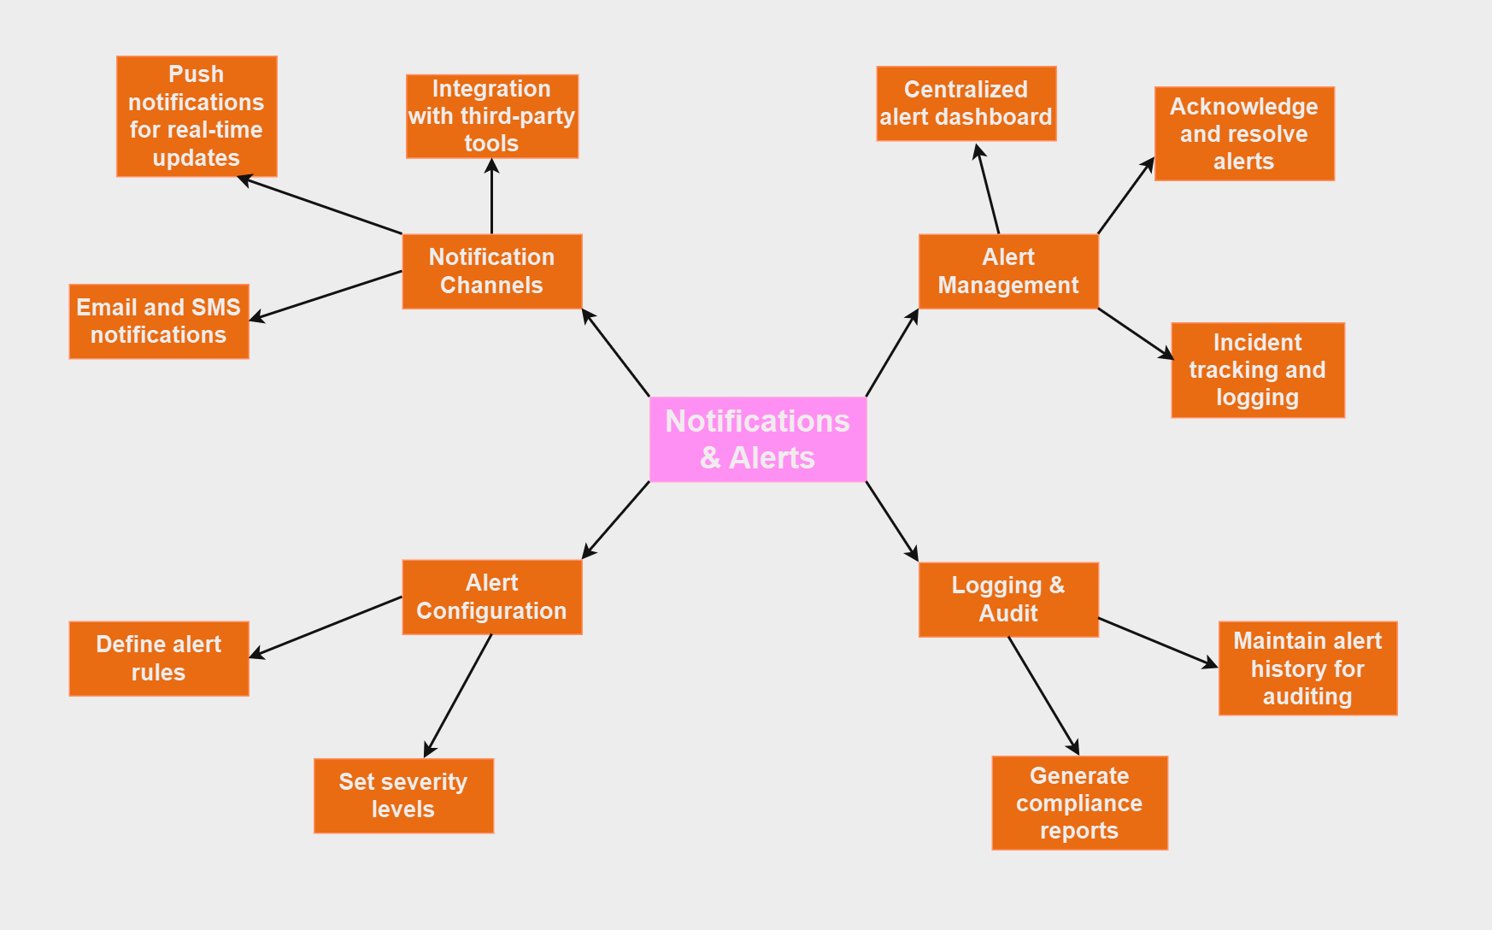

Slide 22
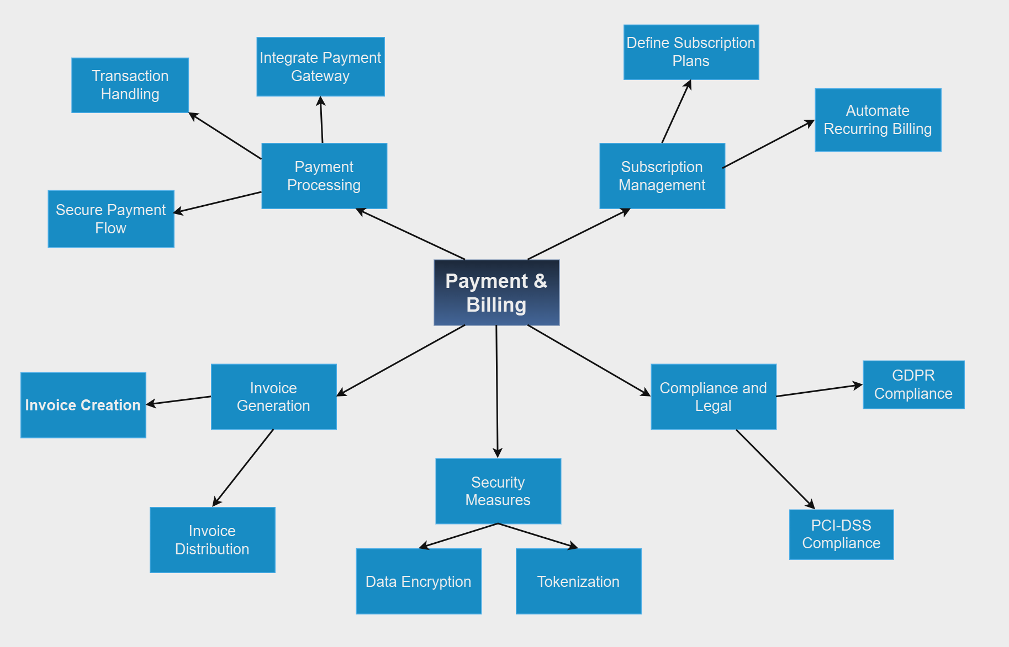

Slide 23
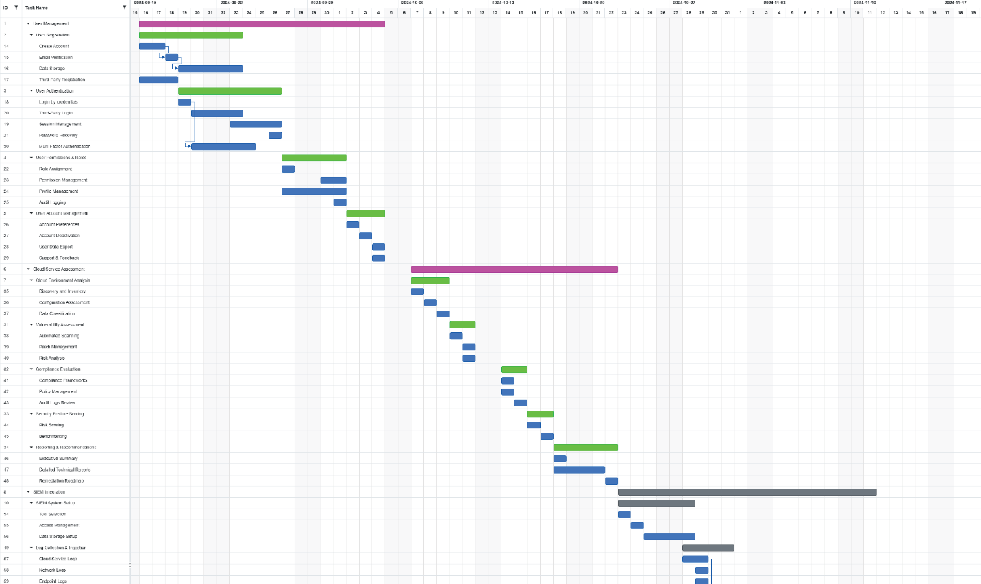
Gantt Chart

Slide 24
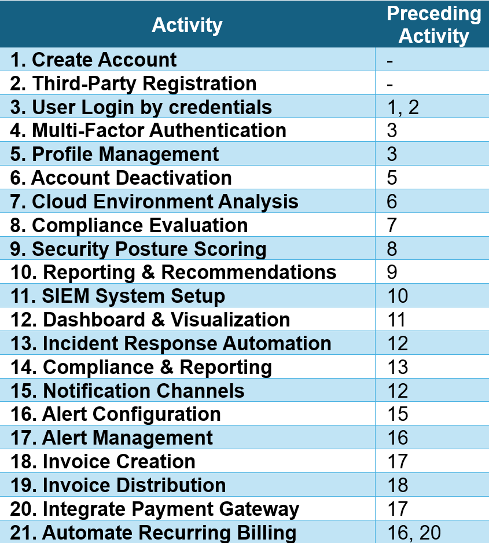
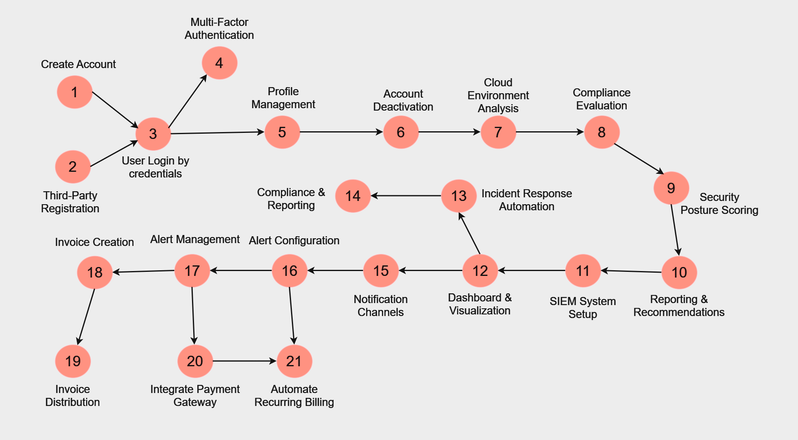
CPM

Slide 25
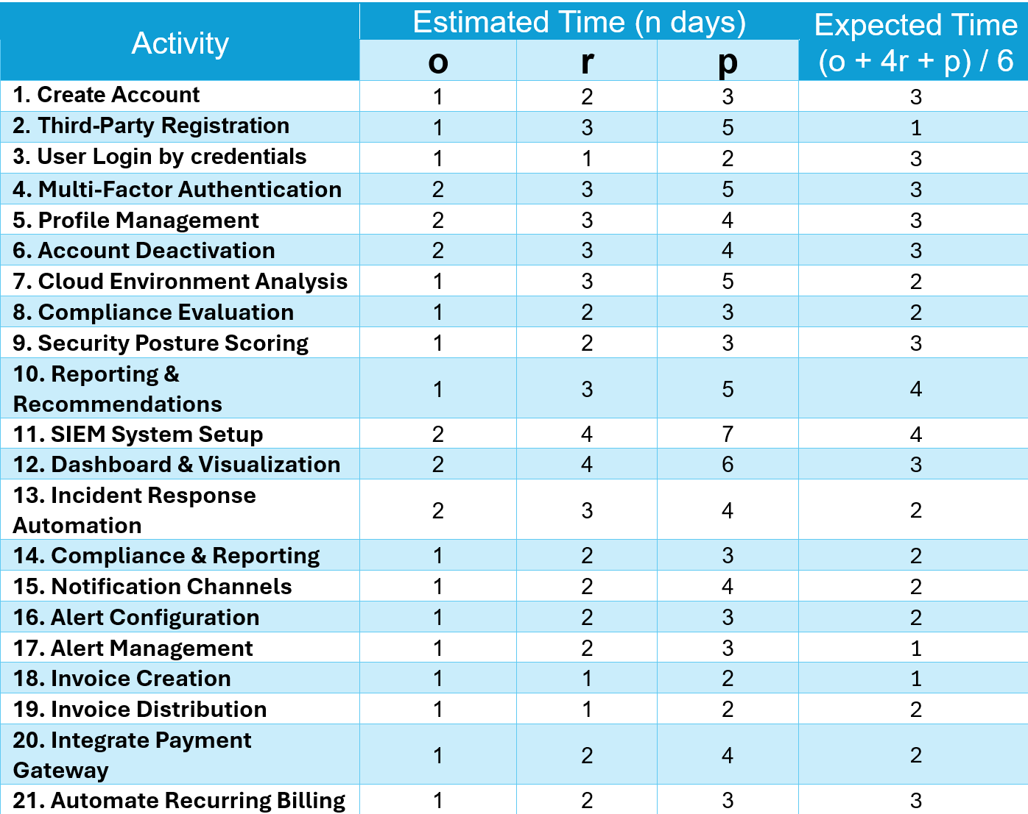
PERT Chart

Slide 26
User Requirements
Account Creation and Management:
Users must be able to register by providing basic information (email, phone number, username, password).
Users will receive an email confirmation to verify their account.
Users can reset passwords using a secure process involving email verification.
Account deletion must be possible, ensuring data removal in compliance with regulations like GDPR.
Login and Security:
Users can log in with email/password or third-party OAuth (e.g., Google, GitHub).
Users can enable Multi-Factor Authentication (MFA) for additional security.
The system sends a One-Time Password (OTP) for verification during critical actions or on new devices.
User Dashboard and Profile Management:
Users can update personal details and change passwords after verifying their identity.
A dashboard allows easy access to security settings and account info.
Cloud Security Monitoring:
Users should be able to monitor their cloud security posture with periodic reports on vulnerabilities, misconfigurations, and threats.
The system must alert users about detected risks and provide recommendations.
Compliance and Auditing:
The system should assess cloud services for compliance with standards like GDPR and HIPAA.
Audit logs must be available for tracking user actions and cloud interactions for regulatory purposes.

Slide 27
Functional Requirements
User Registration and Login:
Email and phone verification during registration.
Third-party authentication (OAuth) and secure password hashing (e.g., bcrypt).
OTP verification for sensitive actions like login from new devices.
MFA and OTP:
Support for enabling MFA (e.g., using Google Authenticator).
OTP should be sent for verification, with expiration and a limited time window for entry.
Cloud Security Monitoring:
Integrate with cloud services (e.g., AWS, Azure) to collect security configurations and detect vulnerabilities.
Generate security reports highlighting misconfigurations, risks, and compliance gaps.
Real-time security alerts for threats detected through SIEM integration.
Compliance and Auditing:
The system must provide compliance monitoring with standards like GDPR, HIPAA, and PCI-DSS.
Generate audit logs for every user activity and cloud interaction for traceability and audits.
SIEM Integration:
Collect logs from user activities, cloud events, and API calls to detect and alert on suspicious behavior.
Anomaly detection in cloud usage or login patterns to identify potential threats.
Provide incident response automation (e.g., disabling accounts after multiple failed login attempts).

Slide 28
Non-Functional Requirements
Security:
Encrypt sensitive data both in transit (e.g., TLS) and at rest (e.g., AES-256).
Implement secure authentication mechanisms (password hashing, MFA) and integrate with SIEM for real-time monitoring.
Performance and Scalability:
The system should be able to handle a large number of concurrent users without performance degradation.
Scalable architecture to support future growth of users, cloud services, and security features.
Reliability and Availability:
Achieve 99.9% uptime with high availability and failover mechanisms in place.
Ensure reliable data backup and recovery processes.
Compliance:
Ensure full GDPR and HIPAA compliance in handling user data.
Enable data deletion and retention features to comply with privacy regulations.
Logging and Monitoring:
The system must provide comprehensive logging for all user actions and cloud interactions to ensure security and support compliance audits.
Integrate with a SIEM platform to analyze logs and trigger real-time alerts for security events.

Slide 29
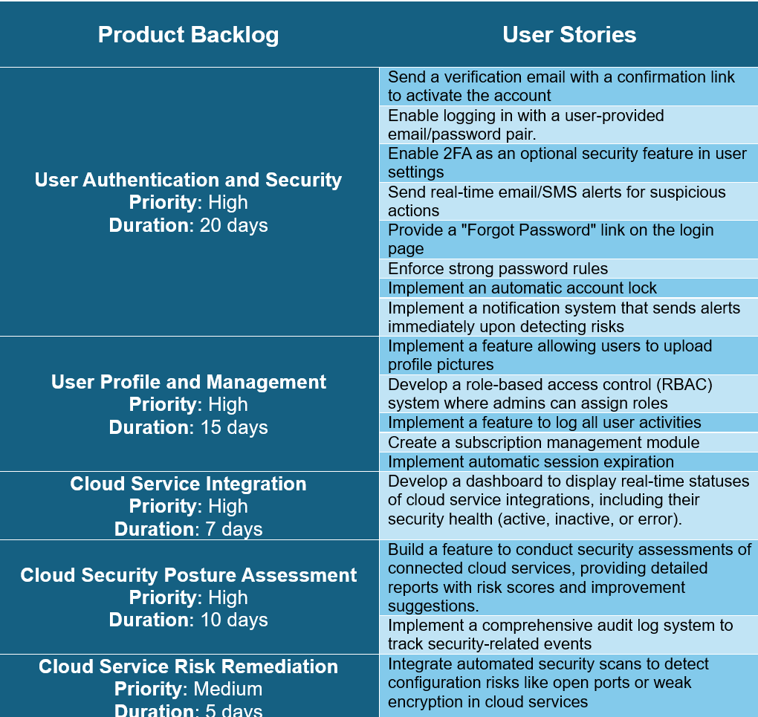
Product Backlogs

Slide 30
UML Diagrams

Slide 31
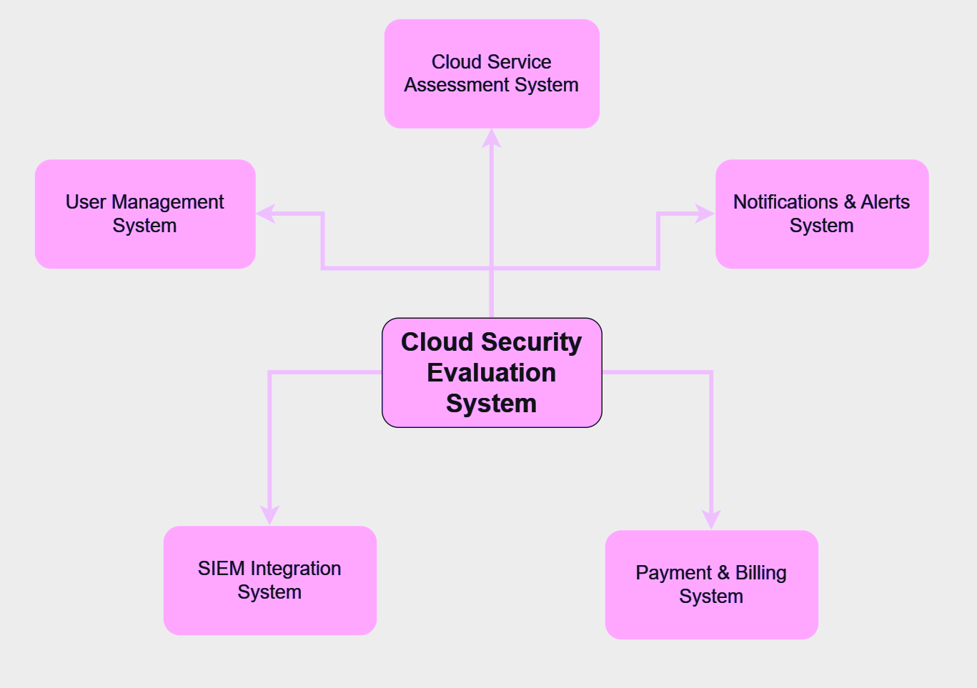
Context Model Diagram

Slide 32
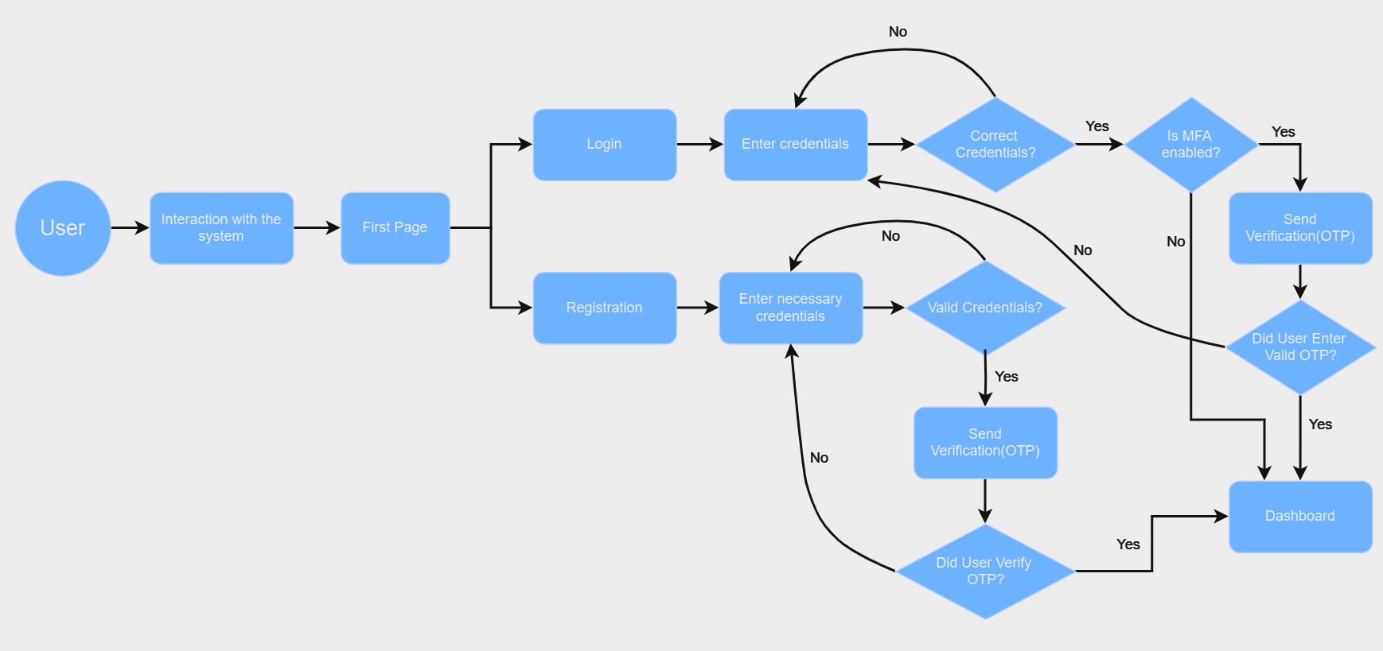
Activity Diagram

Slide 33
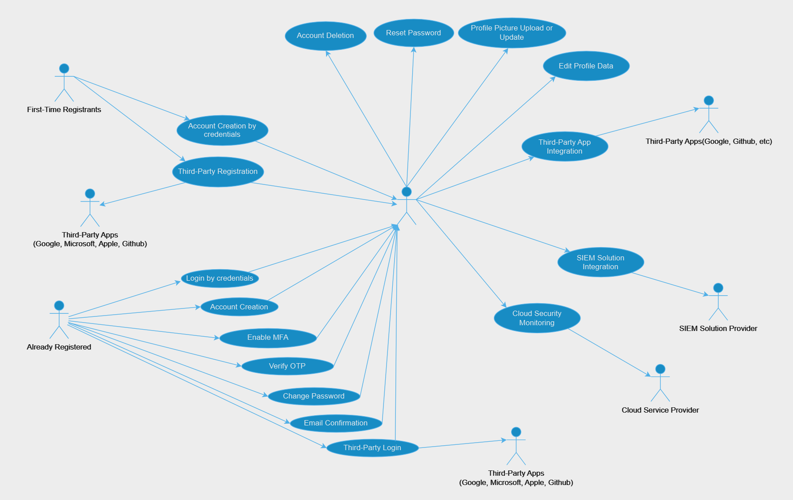
User Case Diagram

Slide 34
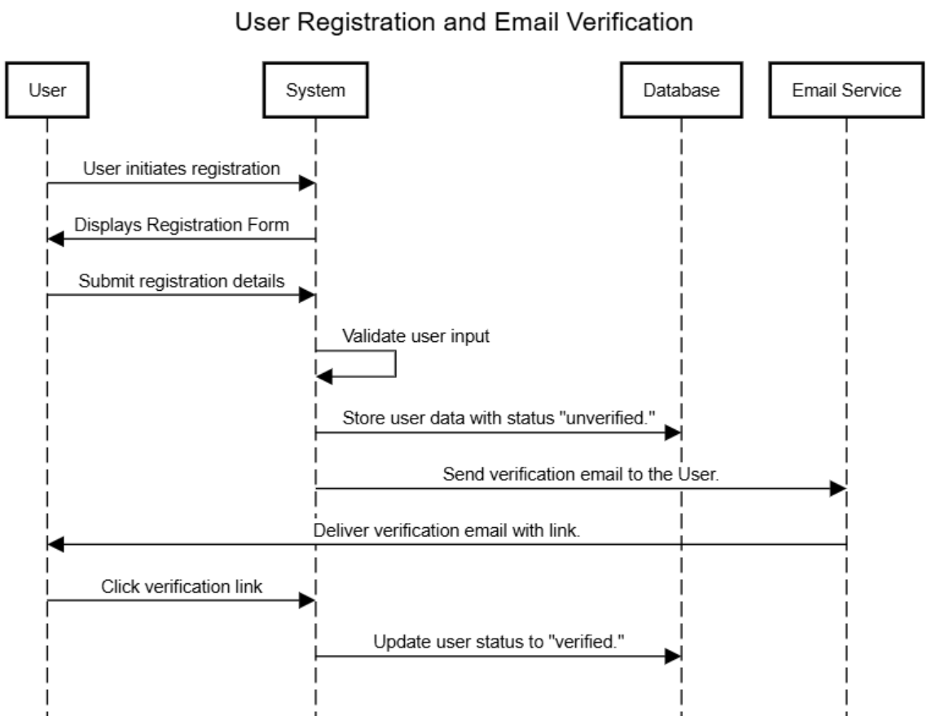
Sequence Diagram(s)

Slide 35
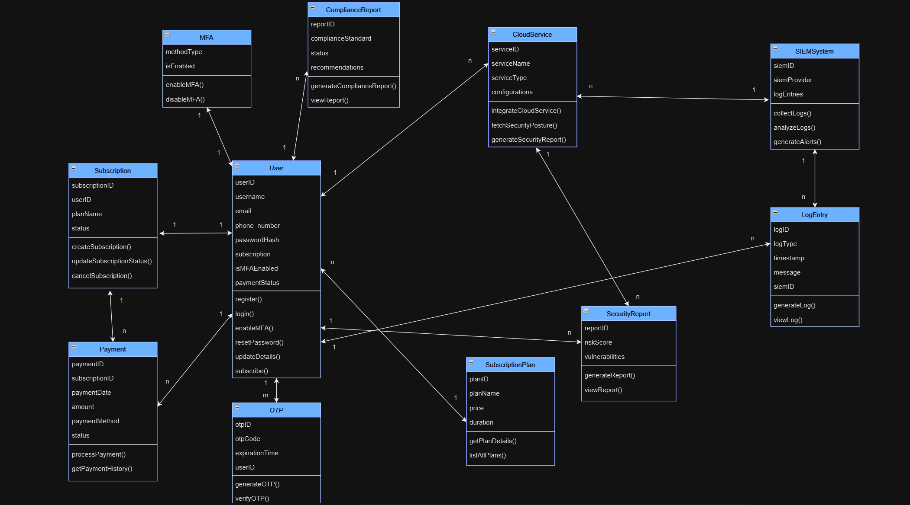
Class Diagram

Slide 36
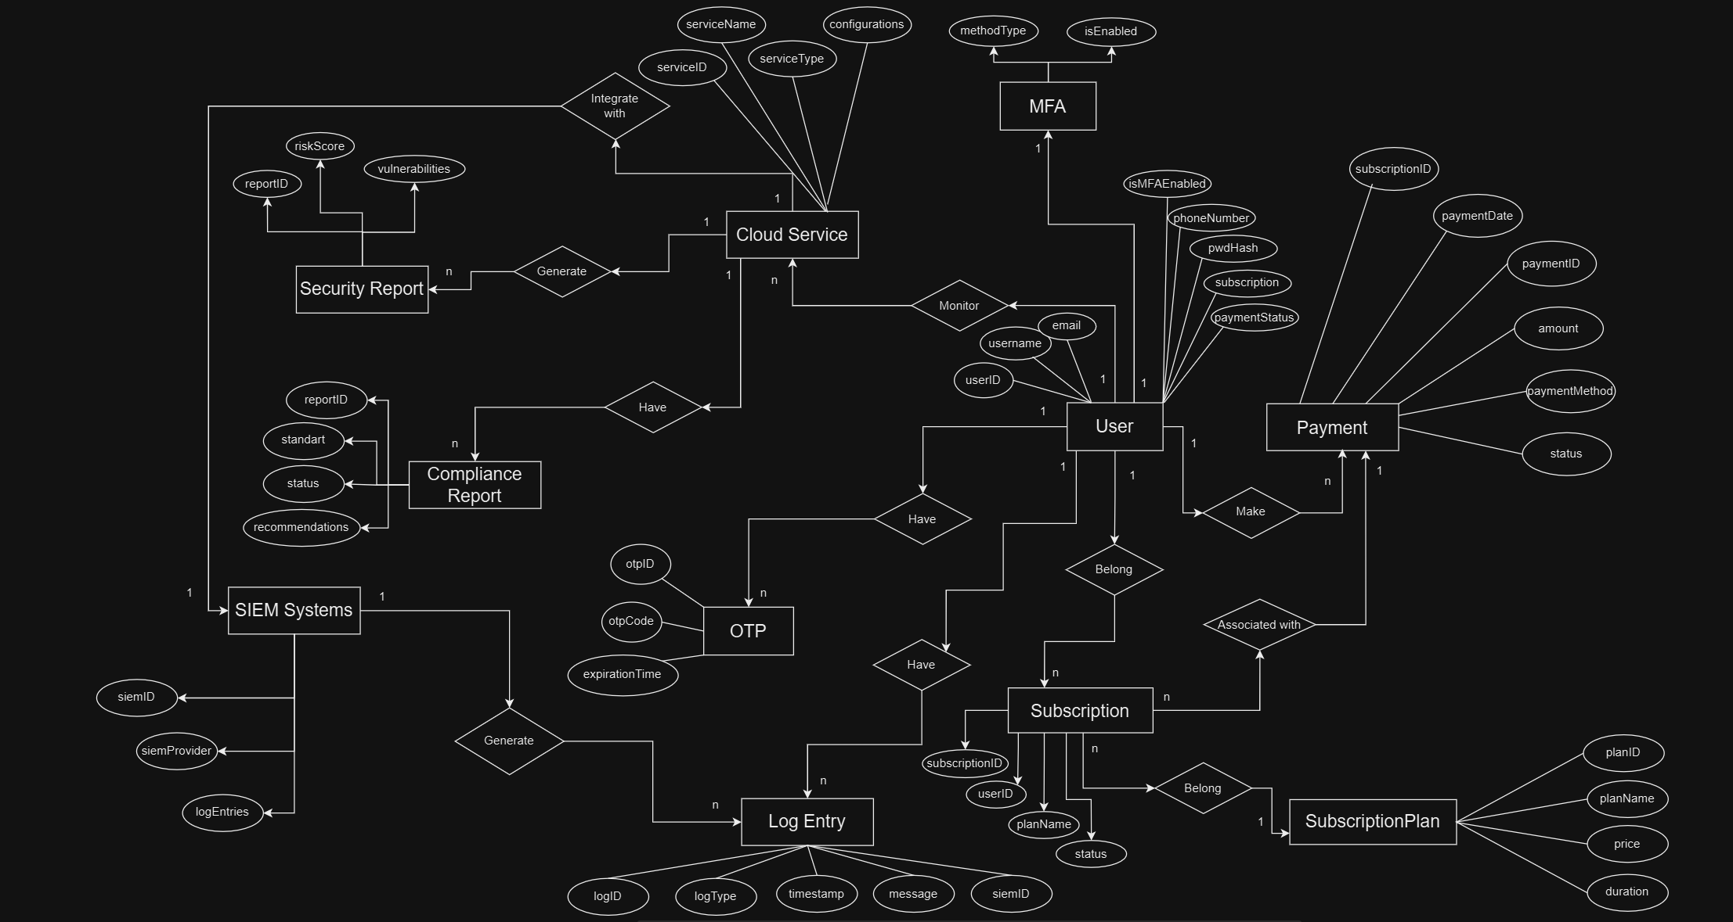
ER Diagram

Slide 37
Test Strategy Documentation

Slide 38
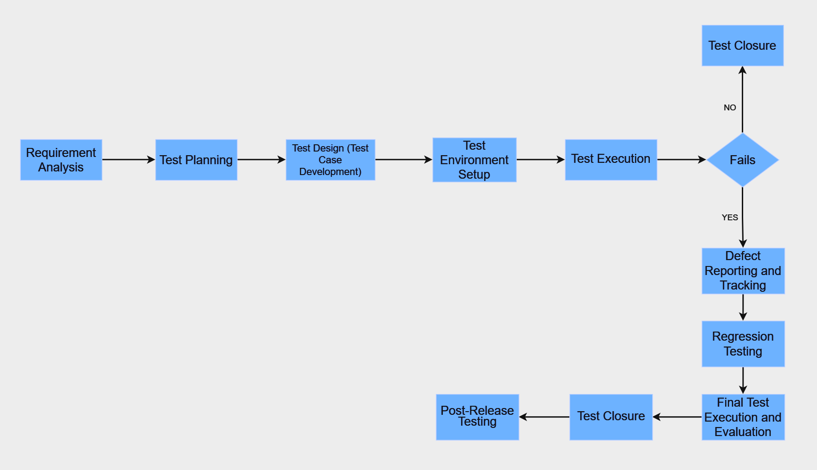
Software Testing Life Cycle

Slide 39
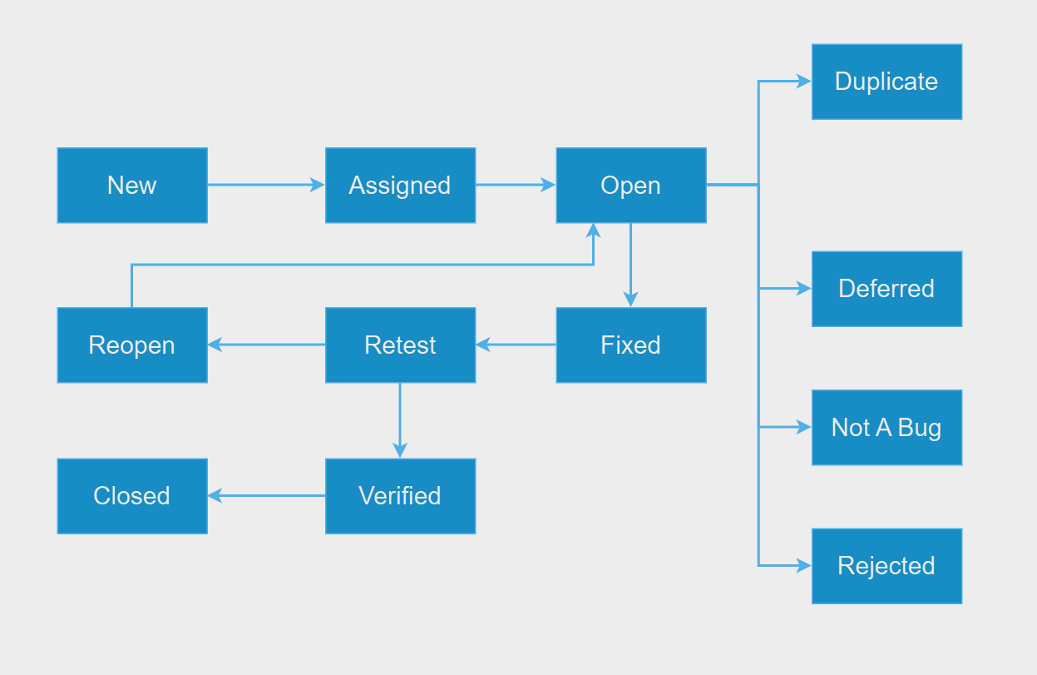
Defect Management Life Cycle

Slide 40
References
https://peakin.in/defect-life-cycle-in-software-testing/
https://www.crowdstrike.com/en-us/cybersecurity-101/cloud-security/cloud-security-assessment/#:~:text=By%20reviewing%20the%20organization's%20network,improve%20capabilities%20in%20the%20future.
https://aimconsulting.com/insights/evaluate-cloud-service-provider-security-benefits-criteria/
https://www.techtarget.com/searchsecurity/tip/How-to-conduct-a-cloud-security-assessment
https://www.mimecast.com/blog/what-is-cloud-siem/

Slide 41
Thanks!
Do you have any questions?
ziya.malikov.std@bhos.edu.az
www.linkedin.com/in/ziya-malikov-b941a7272
+994 70 939 93 39

